Slide 1
Unity based shooting game
Survival of The Darest

Slide 2
1.Introduction 2.REQUIREMENTS 3.CONCLUSION 4.GANTT CHART

Slide 3
introduction
Welcome to the harrowing world of "Survival of the Darest," a gripping and expansive 3D shooter game that will put your survival instincts to the ultimate test. In this immersive gaming experience, you are thrust into a dystopian future on the brink of collapse, where only the strongest and most resourceful will endure.

Slide 4
supervisor
Dr. Ankit Verma
(Assistant professor)
KIET Group of Instituition

Slide 5
REQUIREMENTS
Minimum Hardware Requirements-
4 core processor
2gb of hard disk space
Basic IOT devices
Software Requirements
Unity development kit
C# code editor
Visual studios 2019-2022

Slide 6
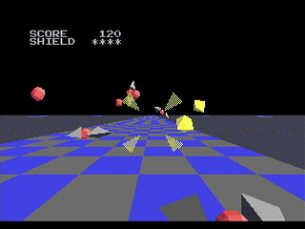
MODULE Player
Immersion is a critical element in 3D shooter games. Engaging gameplay mechanics, such as dynamic combat, resource management, and character progression, contribute to player immersion. "Survival of the Darest" integrates these mechanics to create a challenging and captivating experience.
: Effective game design is crucial for 3D shooters. "Survival of the Darest" incorporates stunning visuals, realistic physics, and atmospheric audio design to immerse players in its world. Attention to detail in aesthetics contributes to player enjoyment.

Slide 7





Conclusion
Post-Apocalyptic Setting
Immersive Gameplay
Engaging Narrative
STRATEGY
Balancing and Difficulty

Slide 8

GANTT CHART

Slide 9
THANK YOU
Ujjwal Aggarwal
MCA SEC-A SEM-3
Roll No-2200290140167

